Slide 2
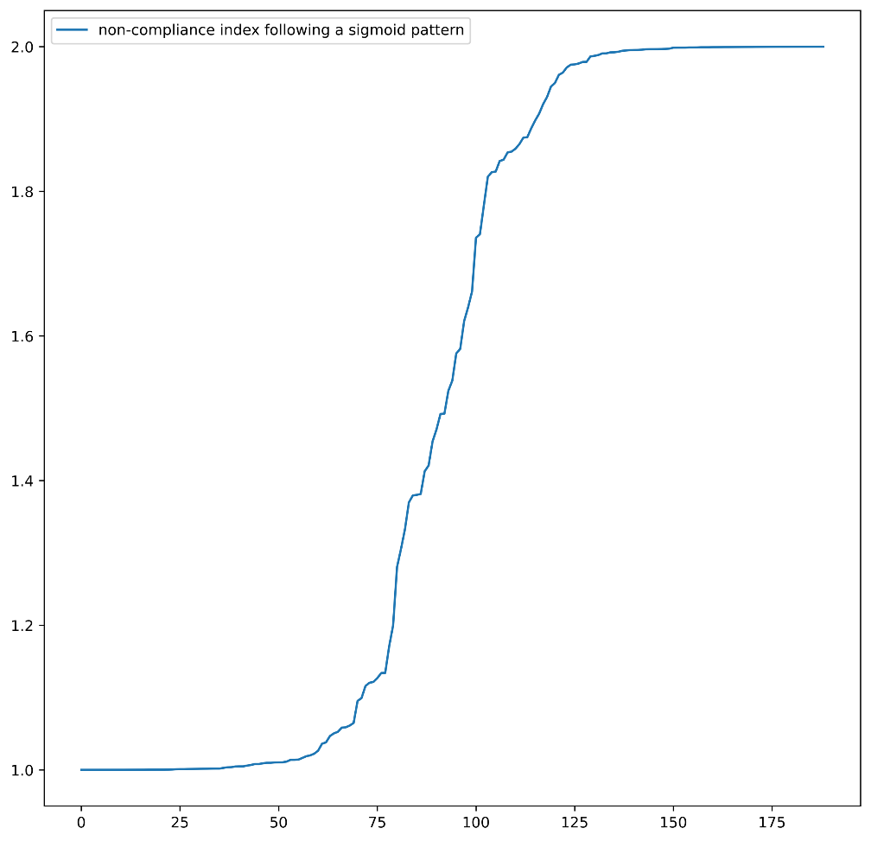
敏感度分析 Sensitivity Analysis
Fig. Sigmoid Model Demonstration Why Sigmoid? 跳转

Slide 3
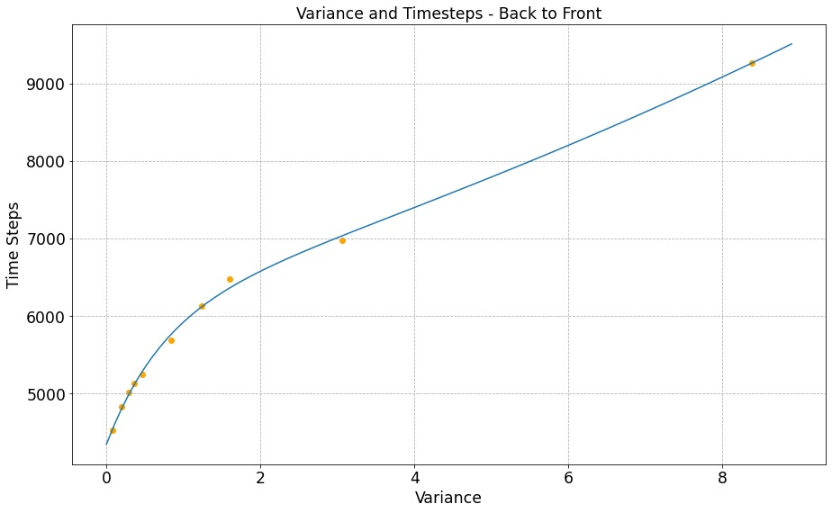
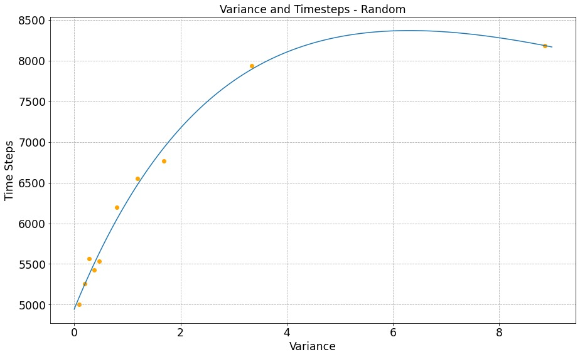
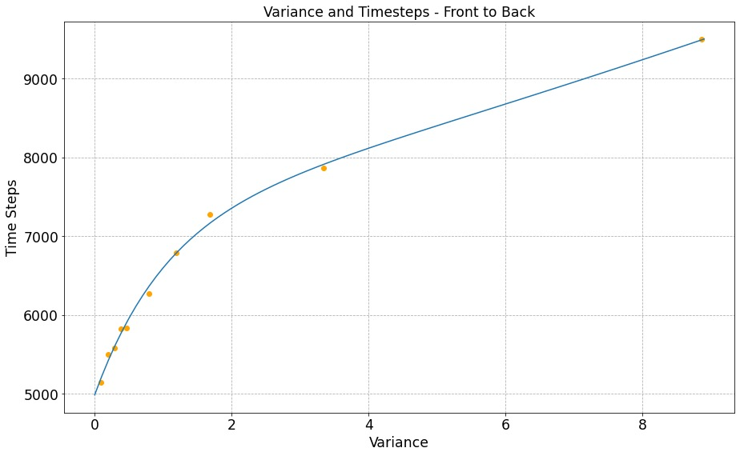
敏感度分析 Sensitivity Analysis
Case 1: A Longer Stowing Time
When considering the comparison on longer stowing time and variance, we define Stable functions as those with Linear graphs. We can see from the graph above that Random boarding is the most sensitive, as it’s the only Unstable graph.
Fig. Comparison on Longer Stowing Time, Variance

Slide 4
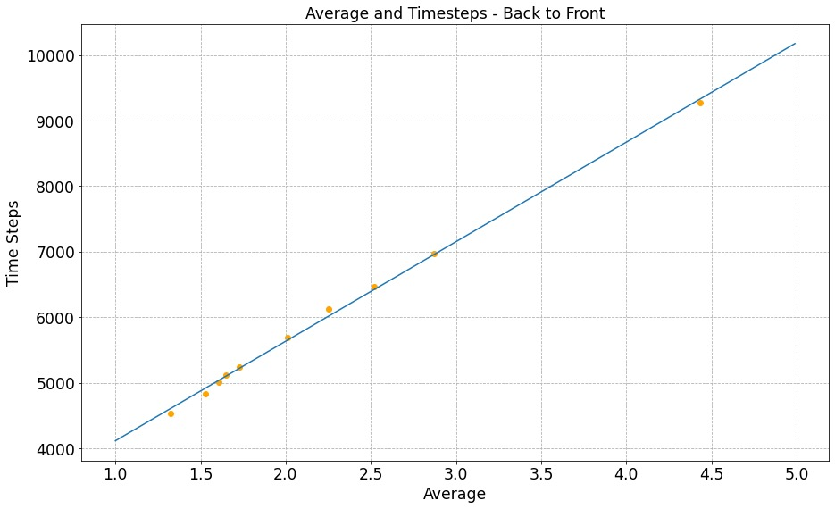
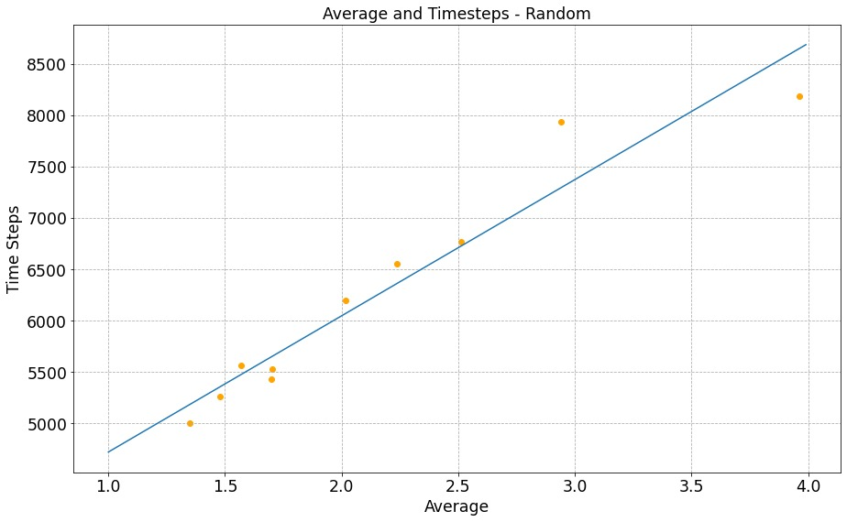
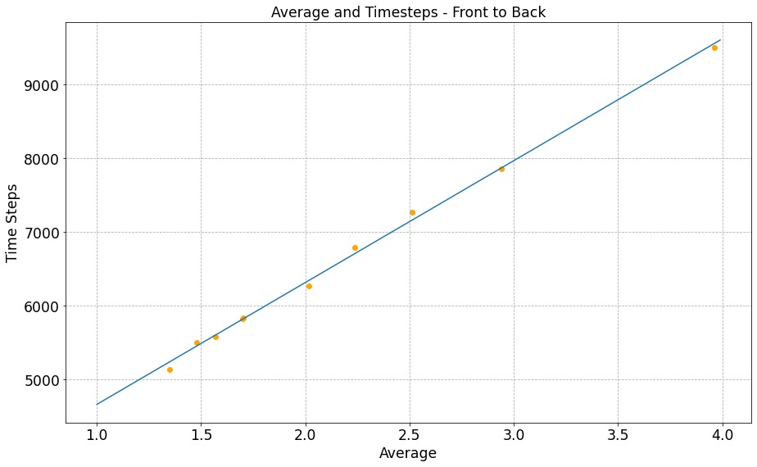
敏感度分析 Sensitivity Analysis
Case 1: A Longer Stowing Time
Random boarding is the most sensitive while Front-to-Back method seems totally not sensitive, as the points on the second graph (random) are farther from the line than that of the other two graphs.
Fig. Comparison on Longer Stowing Time, Overall Time

Slide 5
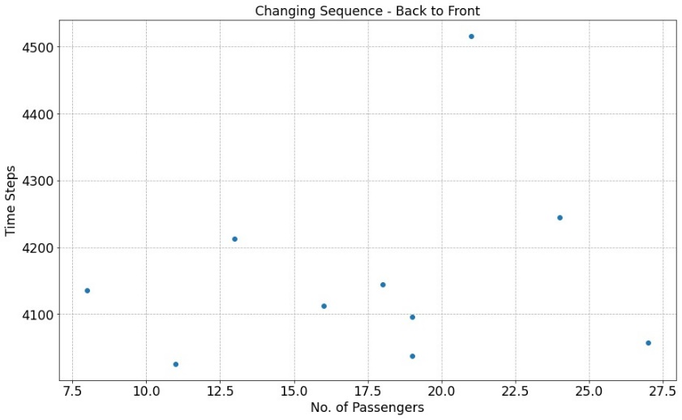
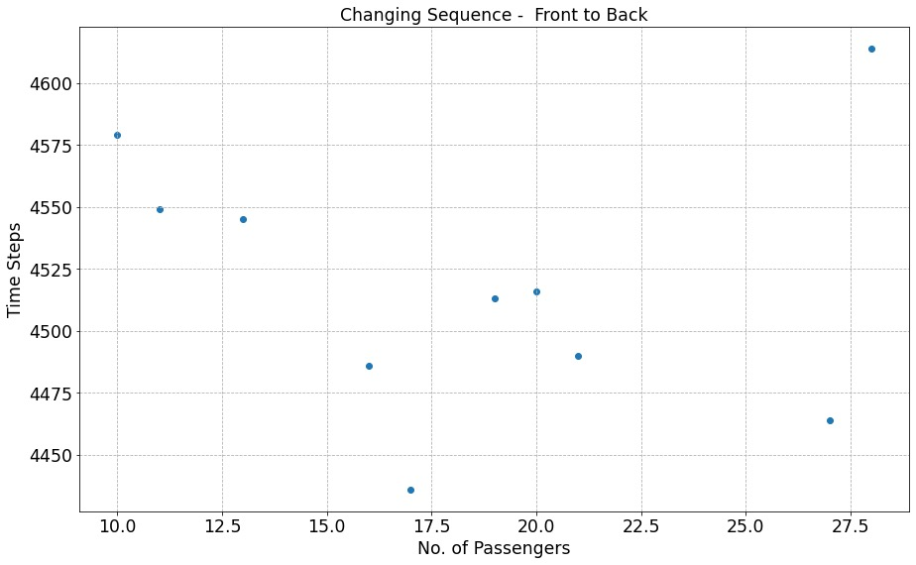
敏感度分析 Sensitivity Analysis
Case 2: Queue Jumping
Both Methods are Sensitive which makes a Big Impact on Total Results, as shown on the graph, the points are irregularly distributed.
Fig. Comparison on Queue Jumping

Slide 6

敏感度分析 Sensitivity Analysis
We use Sigmoid Model for Random Distribution $σ\left(x\right)=−\frac{1}{1+e^{−x}}→σ^{′}(x)$
Commonly Used in Statistics
Usage determined by nature of function: $ℝ→$A Custom Range,
reaching the limit at both ends with linear in the middle
图：Sigmoid模型范例
Fig. Sigmoid Model Demonstration

